Slide 1
Digital Portfolio
STUDENT NAME: S.HEMAVATHI
REGISTER NO AND NMID: asunm1685222409627 and 0BD3C929EB927209AC542F0548ABDF87
DEPARTMENT:B.Sc (Computer science)
COLLEGE: OM SHANTI ARTS AND SCIENCE COLLEGE/ MADRAS UNIVERSITY

Slide 2
PROJECT TITLE
A portfolio is an essential tool for showcasing your skills and projects to potential employers. It's a curated collection of your best work that demonstrates your abilities, creativity, and problem-solving skills.

Slide 3


AGENDA
Problem Statement
Project Overview
End Users
Tools and Technologies
Portfolio design and Layout
Features and Functionality
Results and Screenshots
Conclusion
Github Link
3/21/2024 Annual Review

Slide 4

PROBLEM STATEMENT
In today’s increasingly digital world, individuals and professionals across various fields face challenges in effectively showcasing their skills, experiences, and achievements to potential employers, clients, or collaborators. Traditional resumes and paper-based portfolios are often static, limited in content types (e.g., text only), and lack interactivity.

Slide 5

PROJECT OVERVIEW
In the modern digital era, maintaining a strong online presence is essential for students, professionals, and creatives alike. A digital portfolio serves as a personalized platform to showcase an individual’s skills, achievements, work samples, and professional background in a visually appealing and easily accessible format.

Slide 6

WHO ARE THE END USERS?
The end users of a digital portfolio vary based on the purpose of the portfolio and the profession of

Slide 7

TOOLS AND TECHNIQUES
Creating a professional and functional digital portfolio involves the use of various development tools, design platforms, and techniques. These ensure the final product is visually appealing, responsive, and user-friendly.

Slide 8
POTFOLIO DESIGN AND LAYOUT
A well-structured and visually appealing design and layout is essential for creating a professional digital portfolio. It helps deliver content in a clear, organized, and engaging manner, ensuring a great user experience and effective communication of the creator's skills and work.
8

Slide 9
FEATURES AND FUNCTIONALITY
A well-designed digital portfolio must be visually appealing, easy to navigate, and packed with features that effectively showcase the user's skills, work, and personality.

Slide 10
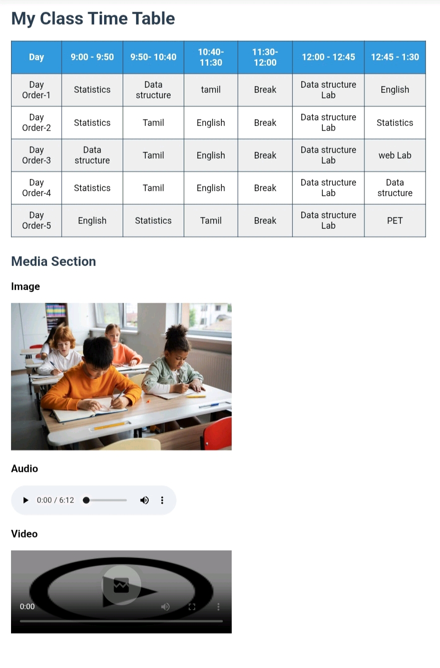
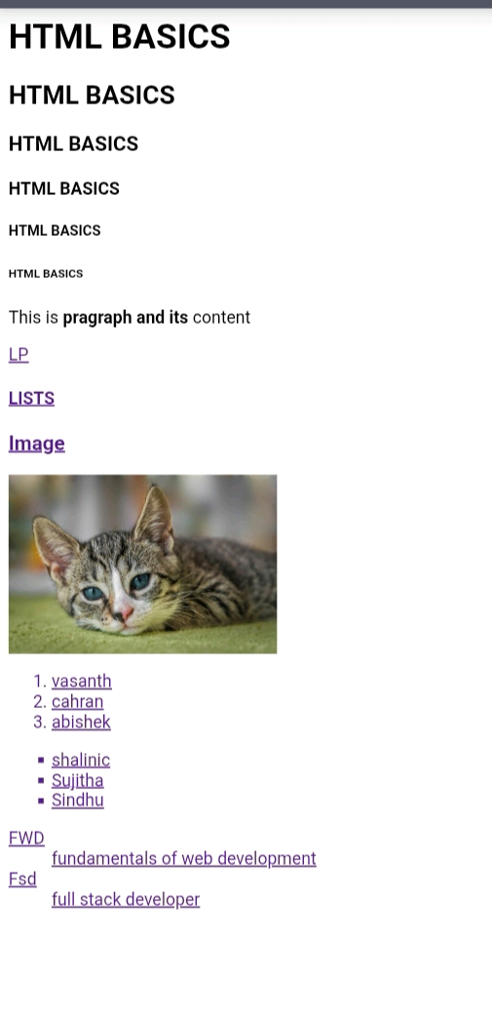

RESULTS AND SCREENSHOTS
3/21/2024 Annual Review
10

Slide 11
CONCLUSION
I believe my projects speak for themselves, demonstrating my ability to build robust applications from the ground up. I am always looking for new challenges and opportunities to learn and grow. Thank you again for your time; you can find my resume and contact information below.
11

